Slide 1
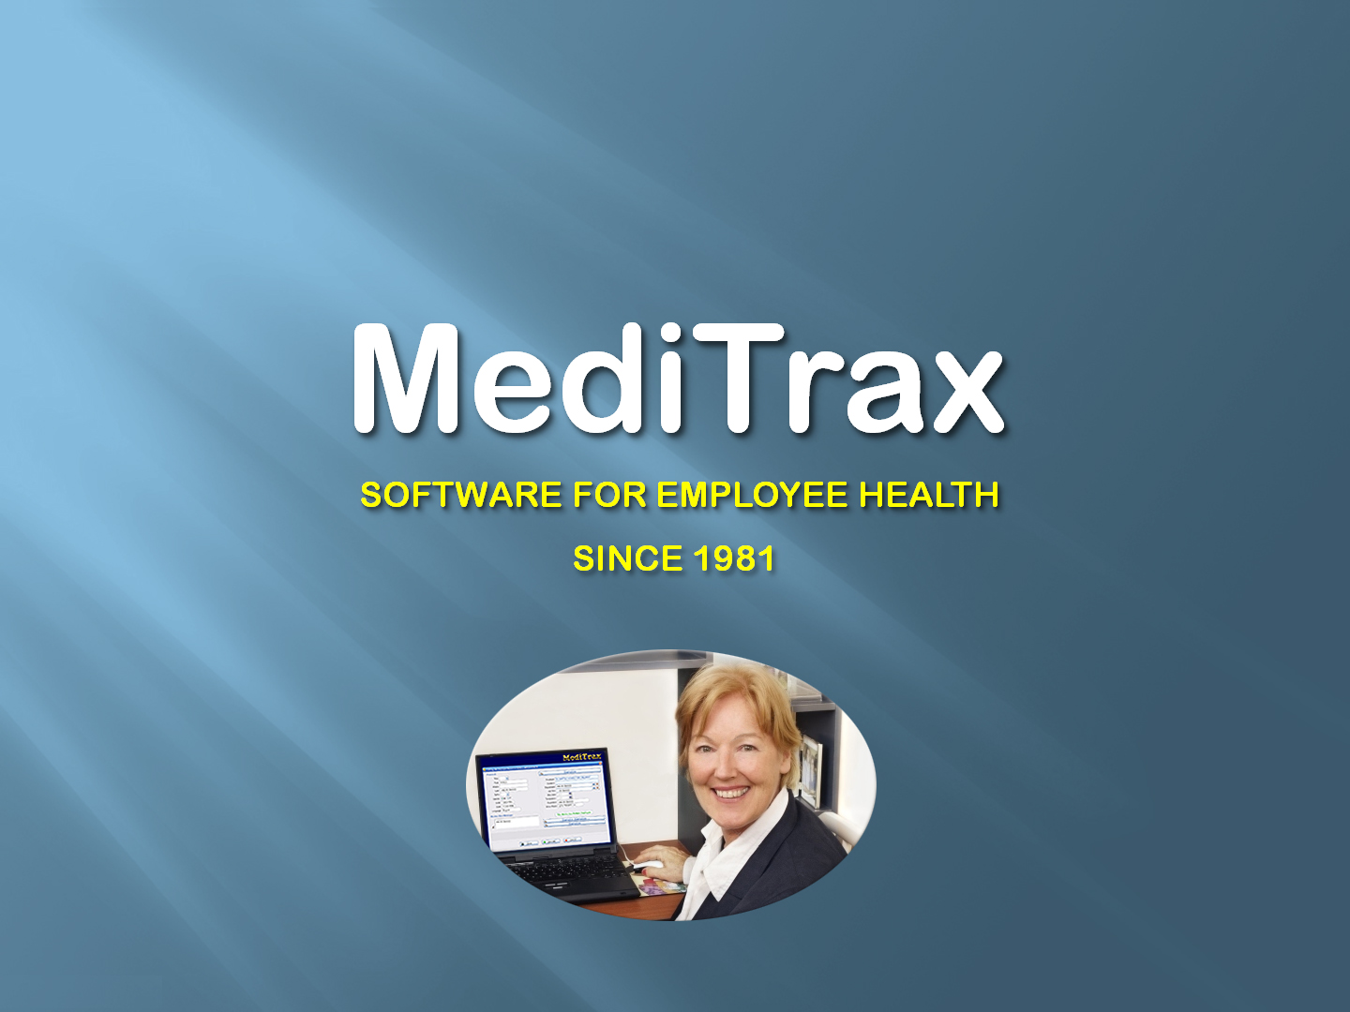
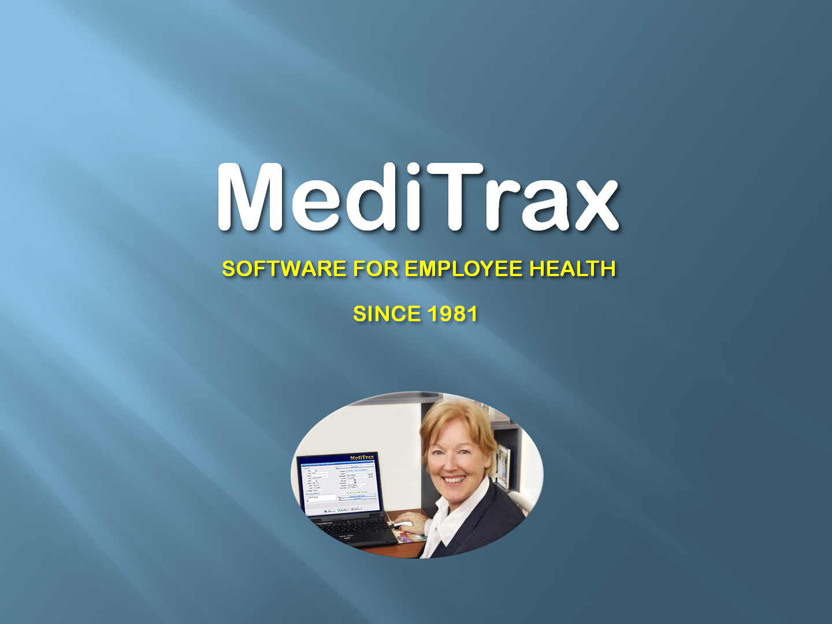

Slide 2
MediTrax is
A complete PAPERLESS software solution
  Designed by experienced Employee Health clinicians and program managers
User-friendly
Flexible and customizable
Affordable

Slide 3
MediTrax is
A Complete PAPERLESS Software Solution
  HIPAA-compliant data entry, storage, and retrieval
  Fully integrated EMR dashboard
  Unlimited scanned documents may be attached to each Employee’s EMR
  Point-and-click documentation and reporting of immunizations, titers, TB surveillance, BBP exposures, “sharps” injuries, occupational injuries/ exposures/illnesses, respirator fit testing, drug testing, audiometry, color vision testing, FMLA
  leave, sick leave, inservice training, etc.

Slide 4
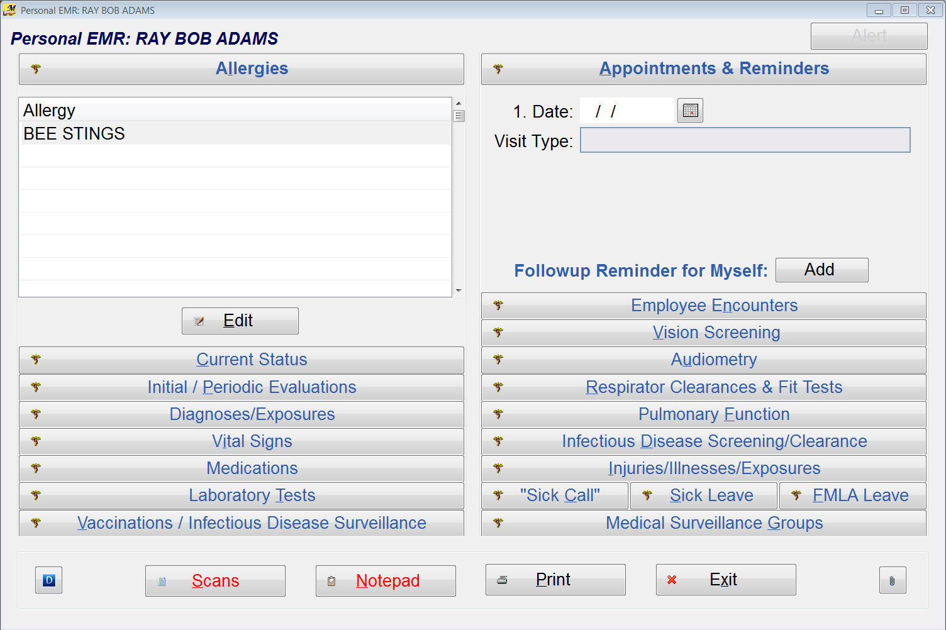
MediTrax EMR Dashboard

Slide 5
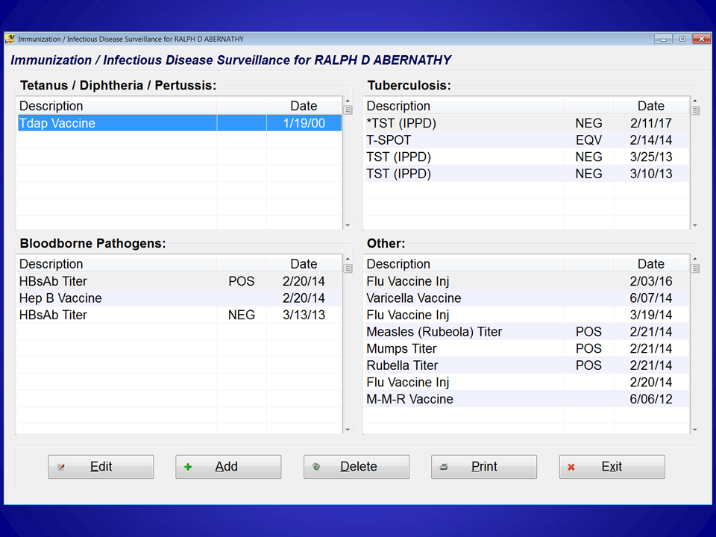
  Immunization Summary at a Glance

Slide 6
MediTrax is
A Complete PAPERLESS Software Solution
  Point-and-click clinical status summaries (immunizations, etc.), “who’s-due” rosters, “sharps” and occupational-injury summaries, exposure summaries, policy compliance reporting (including NHSN statistics), workers comp and OSHA reporting (300, 300A, 301)
  “Paperless flu clinics” require 15-20 seconds per employee for documentation, without the need for third-party ID-badge scanning

Slide 7
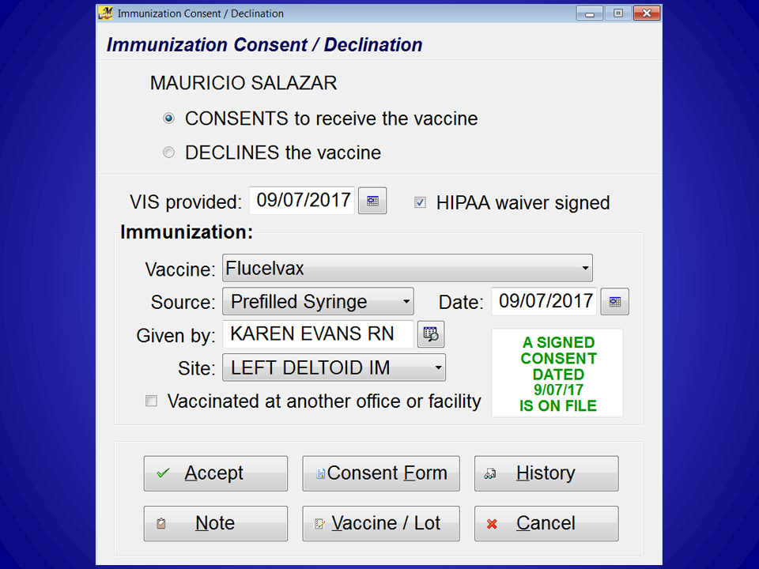
“Paperless Flu Clinic”
Documentation Screen

Slide 8
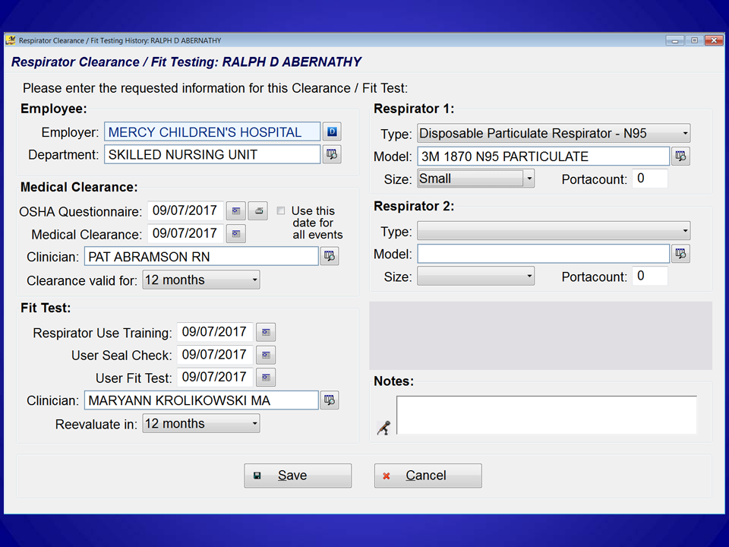
Respirator Clearance / Fit Test
Documentation Screen

Slide 9
MediTrax is
A Complete PAPERLESS Software Solution
  More than 1500 reports in 135 categories available
  Comprehensive compliance reports and NHSN statistics
  Point-and-click appointment scheduling and recall reminders
  Automated e-mail of recall and appointment reminders to employees and supervisors (using
  your Outlook® or other email client)

Slide 10
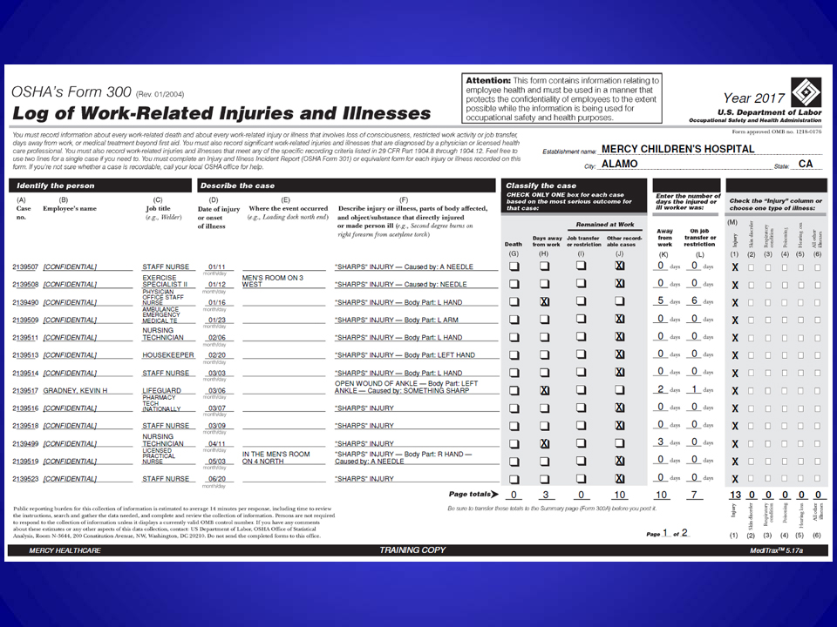
OSHA 300 / 300A / 301 Reports
(generated automatically, in seconds)

Slide 11
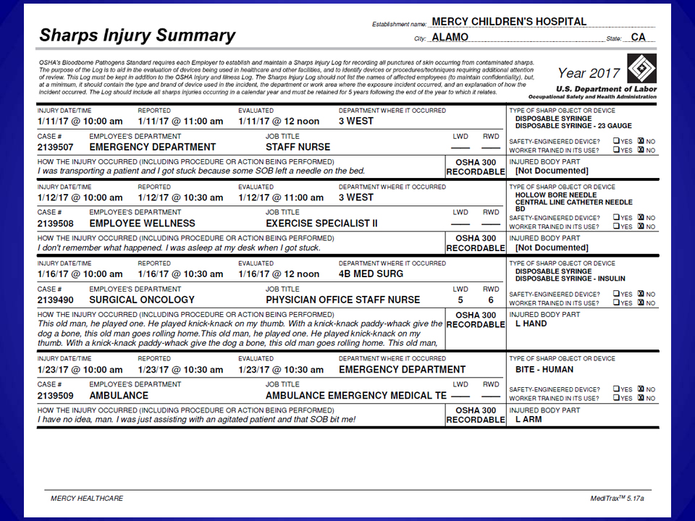
Sharps Injury Summary is generated
on demand for any timespan

Slide 12
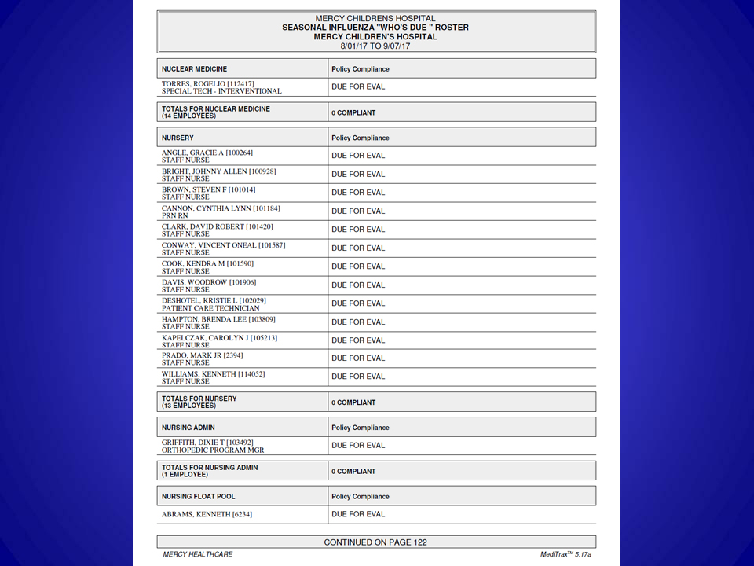
“Who’s Due” Rosters
available on demand

Slide 13
MediTrax is
A Complete PAPERLESS Software Solution
  Customizable forms library includes
    All current CDC VISs
    BBPE exposure guides
    Links to web-based resources and regulations
    User-created forms may be added
  Automated creation of HL7 upload files for state immunization registries

Slide 14
MediTrax is
A Complete PAPERLESS Software Solution
  Employee Portal (available at no extra cost)
  enables employees to log in from their workstation
  and view / print immunization records, read / print CDC VISs, and more...
  Flu vaccine questionnaires and consent forms
  can be completed online and electronically signed
  OSHA Respirator User Questionnaires and TB surveys can be completed online and electronically signed

Slide 15
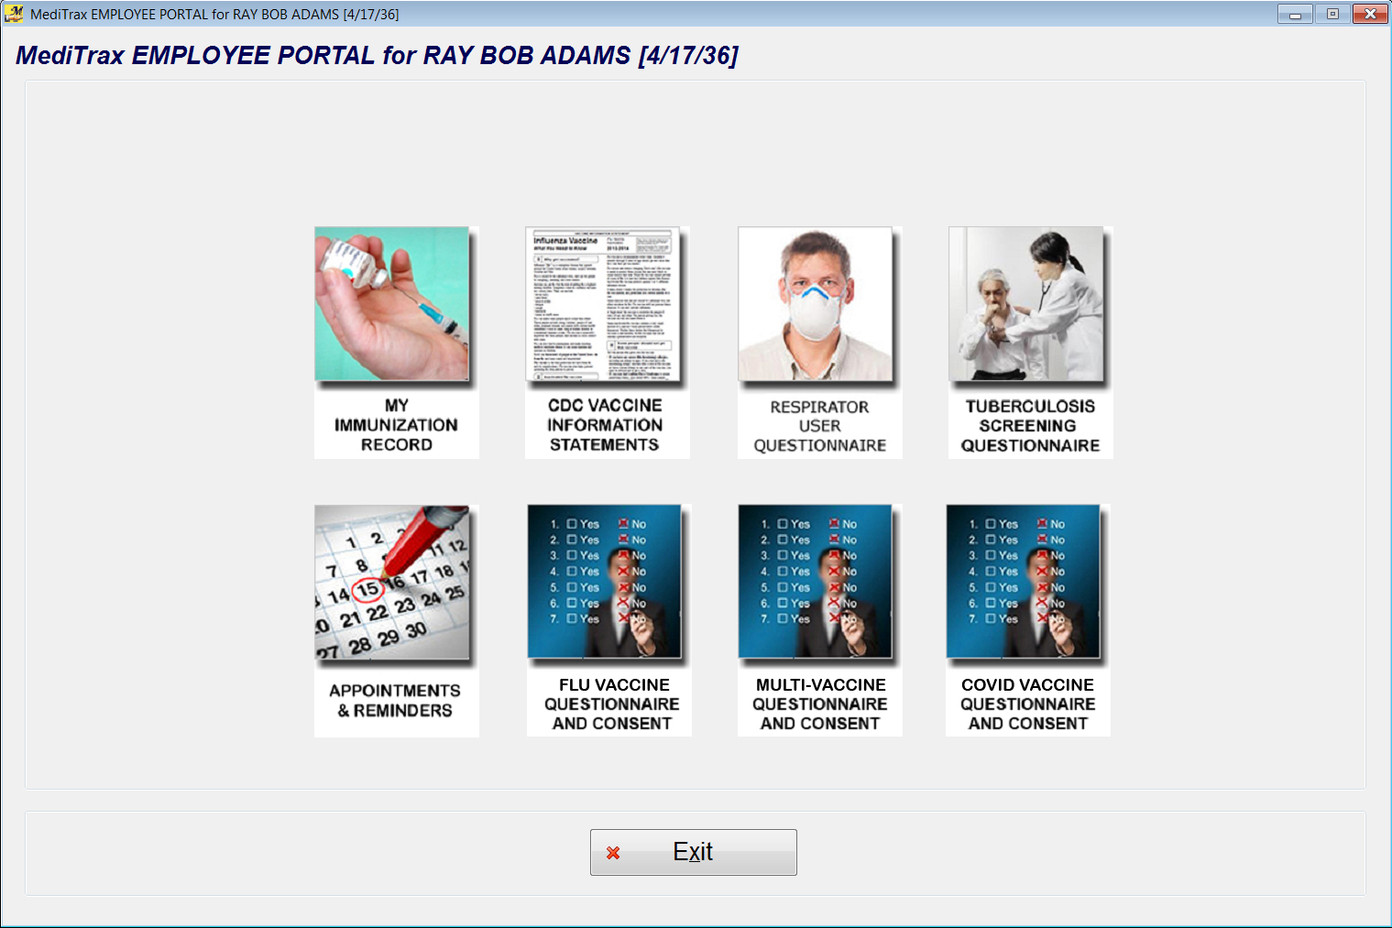

Slide 16
MediTrax is
User-friendly
  Intuitive drop-down menuing speeds workflow
  Point-and-click data entry and reporting is extremely easy to learn
  Records of former (terminated) employees are visible with a single mouse click
  Clinical notes may be typed or dictated
  All reports and summaries can be printed as .PDF documents

Slide 17
MediTrax is
Flexible and Customizable
  User data-access privileges are role-based and locally defined, to ensure confidentiality
  Database may contain unlimited demographic records (employees, contractors, volunteers, students, LIPs, etc.)
  Employee demographics may be updated nightly from your HR database
  Unlimited user-defined Medical Surveillance Groups
  may be created and tracked

Slide 18
MediTrax is
Affordable
  Up-front pricing saves tens of thousands annually when compared to other products
  On-site user training provided by experienced MediTrax users at no extra cost
  No extra fee for data conversion from legacy EH systems (Respond®, OHM®, spreadsheets), with minimal lead time required (usually 48-72 hours)
  No per-user or per-workstation fees

Slide 19
MediTrax is
Affordable
  No extra fee for CutePDF ® printer driver
  No extra fee for 12 months of unlimited support via WebEx®, email, and phone
  Minor customization requests generally implemented
  at no extra charge
  $3,500 per year for unlimited support and all software updates (beginning in year 2, and guaranteed never to increase)

Slide 20
MediTrax is
Affordable
  Discounts are available for Critical Access Hospitals and customers obtaining MediTrax for multiple facilities
  Local or remote hosting options available
  90-day unconditional money-back guarantee of satisfaction following installation and training

Slide 21

MediTrax is

Slide 22
MediTrax
For more information, or to schedule a live overview and demo, please contact us at
925-820-7758
or
support@meditrax.com
Visit us on the web at
www.meditrax.com

